Slide 1
Seminar
3D-R2N2
Cha Jin Hyuck

Slide 2
Index
1
2
3
3D-R2N2
Introduction
3D-R2N2
Structure
3D-R2N2
Detail

Slide 3
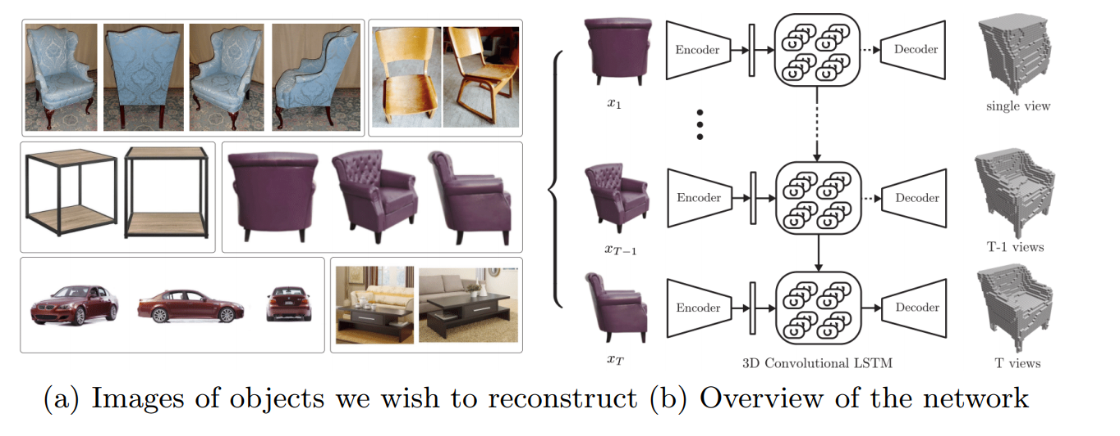
1
An overview of our proposed 3D-R2N2: The network takes a sequence of images from arbitrary (uncalibrated) viewpoints as input and generates voxelized 3D reconstruction as an output.
The reconstruction is incrementally refined as the network sees more views of the object

Slide 4
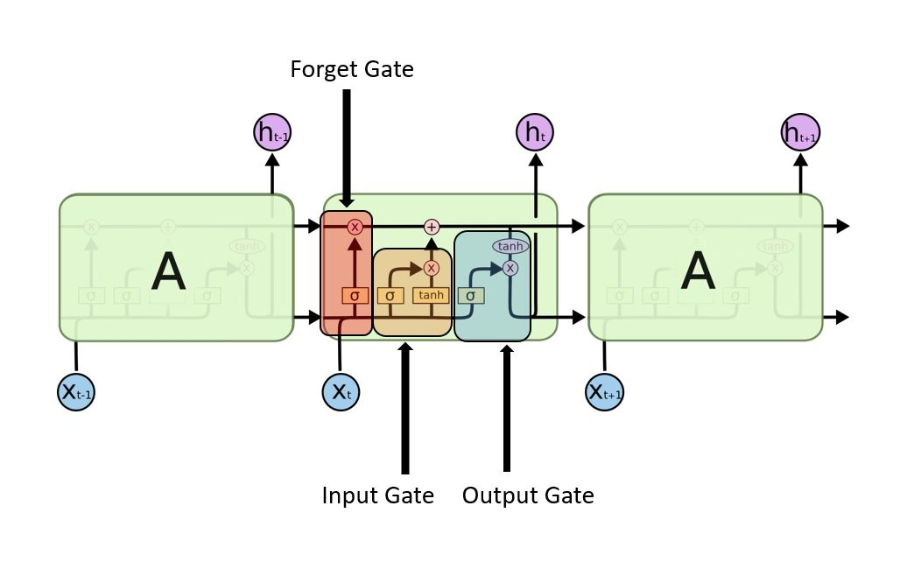
1
Long Short-Term Memory (LSTM)
Why we call the Gate?
Sigmoid control the output vector of Gate

Slide 5
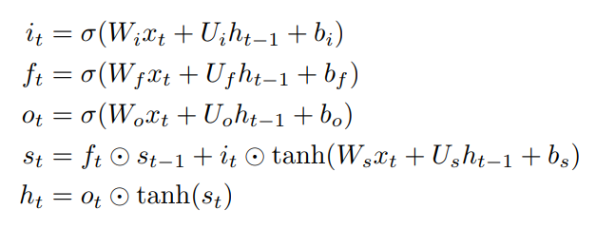
1
Long Short-Term Memory (LSTM)
LSTM overcome the vanishing gradient problem
Specifically, an LSTM unit consists of four components:
memory units (a memory cell and a hidden state)
three gates which control the flow of information from the input to the hidden state (input gate),
from the hidden state to the output (output gate),
from the previous hidden state to the current hidden state (forget gate)

Slide 6
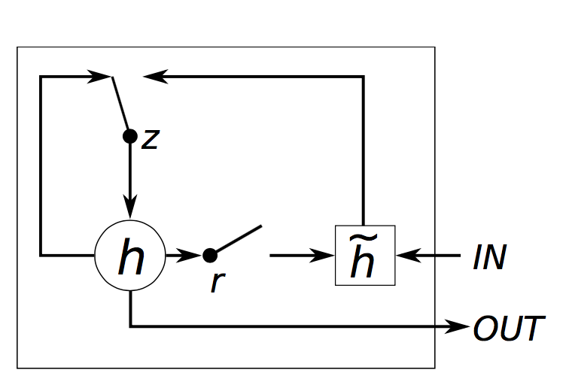
1
Gated Recurrent Unit
An advantage of the GRU is that there are fewer computations compared to the standard LSTM

Slide 7
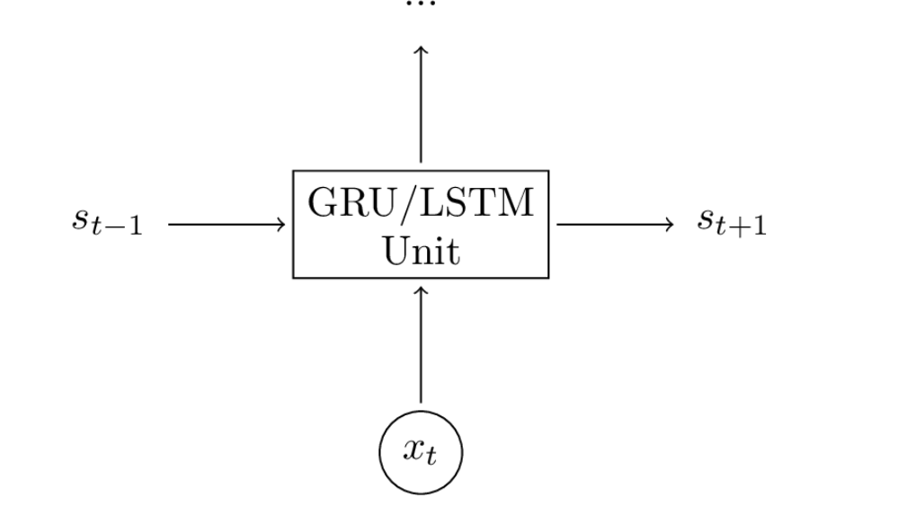
1
Gated Recurrent Unit
Do not think hard, just black box module

Slide 8
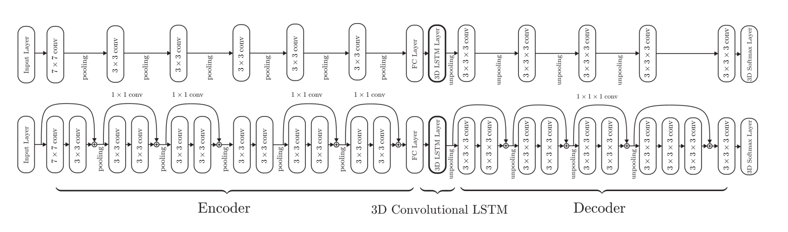
2
Entire structure of 3DR2N2

Slide 9
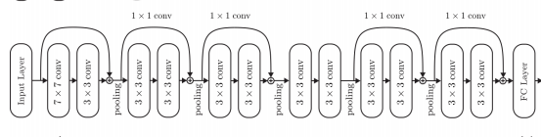
2
Encoder: 2D-CNN
The encoder output is then flattened and passed to a fully connected layer which compresses the output into a 1024 dimensional feature vector

Slide 10
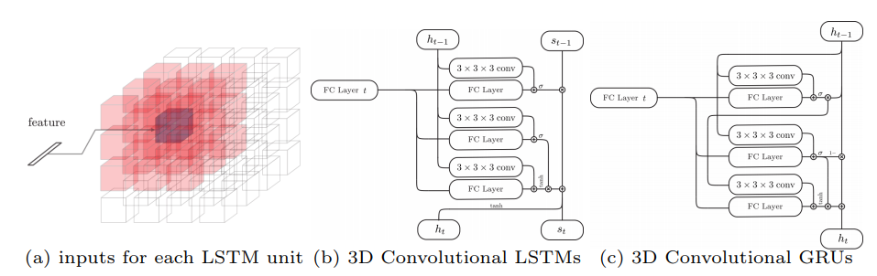
2
3D convolutional LSTM
The network is made up of a set of structured LSTM units with restricted connections. The 3D-LSTM units are spatially distributed in a 3D grid structure, with each unit responsible for reconstructing a particular part of the final output

Slide 11
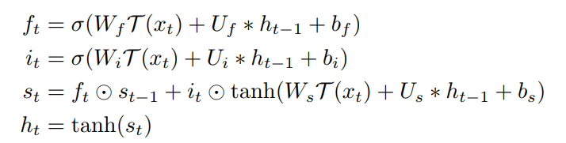
2
3D convolutional LSTM
N = 4
For vanilla LSTMs, all elements in the hidden layer ht−1 affect the current hidden state ht, whereas a spatially structured 3D Convolutional LSTM only allows its hidden states ht,(i,j,k) to be affected by its neighboring 3D-LSTM units for all i, j, and k.

Slide 12
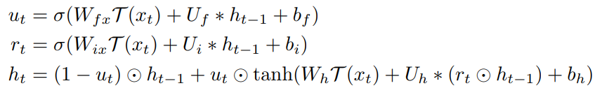
2
3D convolutional LSTM
GRU based

Slide 13
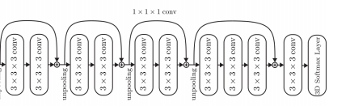
2
Decoder

Slide 14

2
Loss: 3D Voxel-wise Softmax
The loss function of the network is defined as the sum of voxel-wise cross-entropy

Slide 15
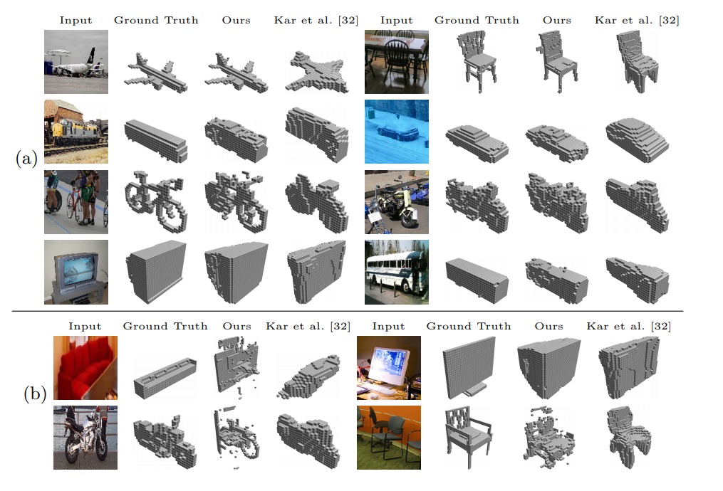
3
Single view reconstruction
The input image size was set to 127 × 127. The output voxelized reconstruction was of size 32 × 32 × 32

Slide 16
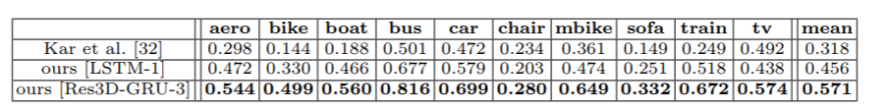
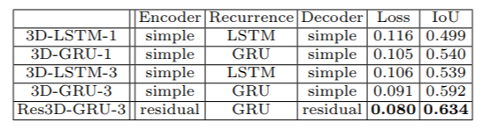
3
Experiment
Single View

Slide 17
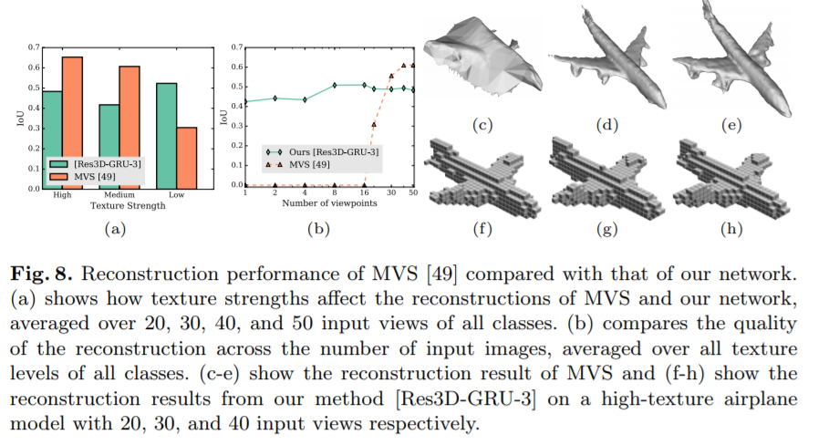
Intersection-over-Union (IoU)
3

Slide 18
3
First, our method could not reconstruct as many details as the MVS method did when given more than 30 different views of the model. Second, our method performed worse in reconstructing objects with high texture levels.
First, we do not need to train and test per-category. Our network 3D-R2N2 11 trains and reconstructs without knowing the object category. Second, our network does not require object segmentation masks and keypoint labels as additional inputs

Slide 19
Thank you

